Slide 1
MongoDB Scans
Rahul
161126

Slide 2
Collection Scan vs. Index Use
If the query planner selects a collection scan, the explain result includes a COLLSCAN stage.
If the query planner selects an index, the explain result includes a IXSCAN stage.

Slide 3
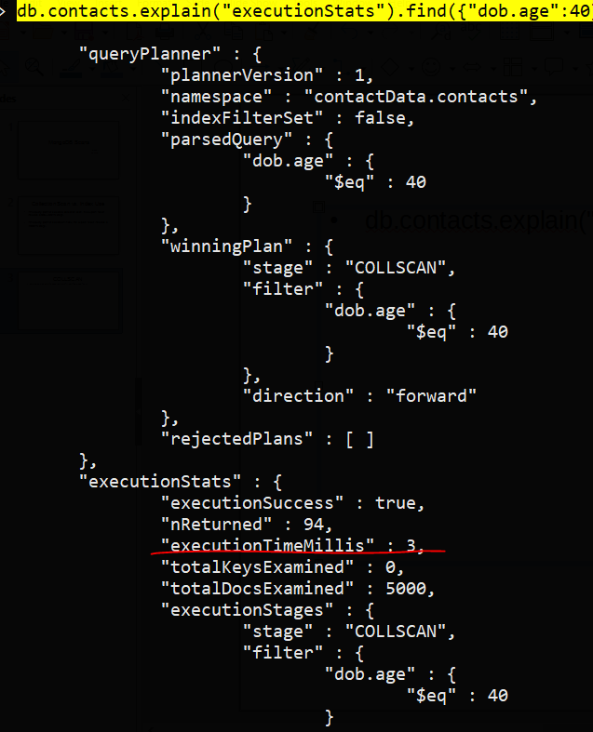
COLLSCAN
db.contacts.explain("executionStats").find({"dob.age":40})

Slide 4
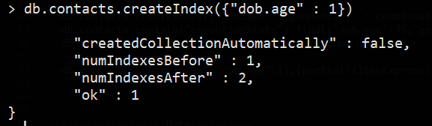
IXSCAN
Creating index :: db.contacts.createIndex({"dob.age" : 1})

Slide 5
